Slide 1
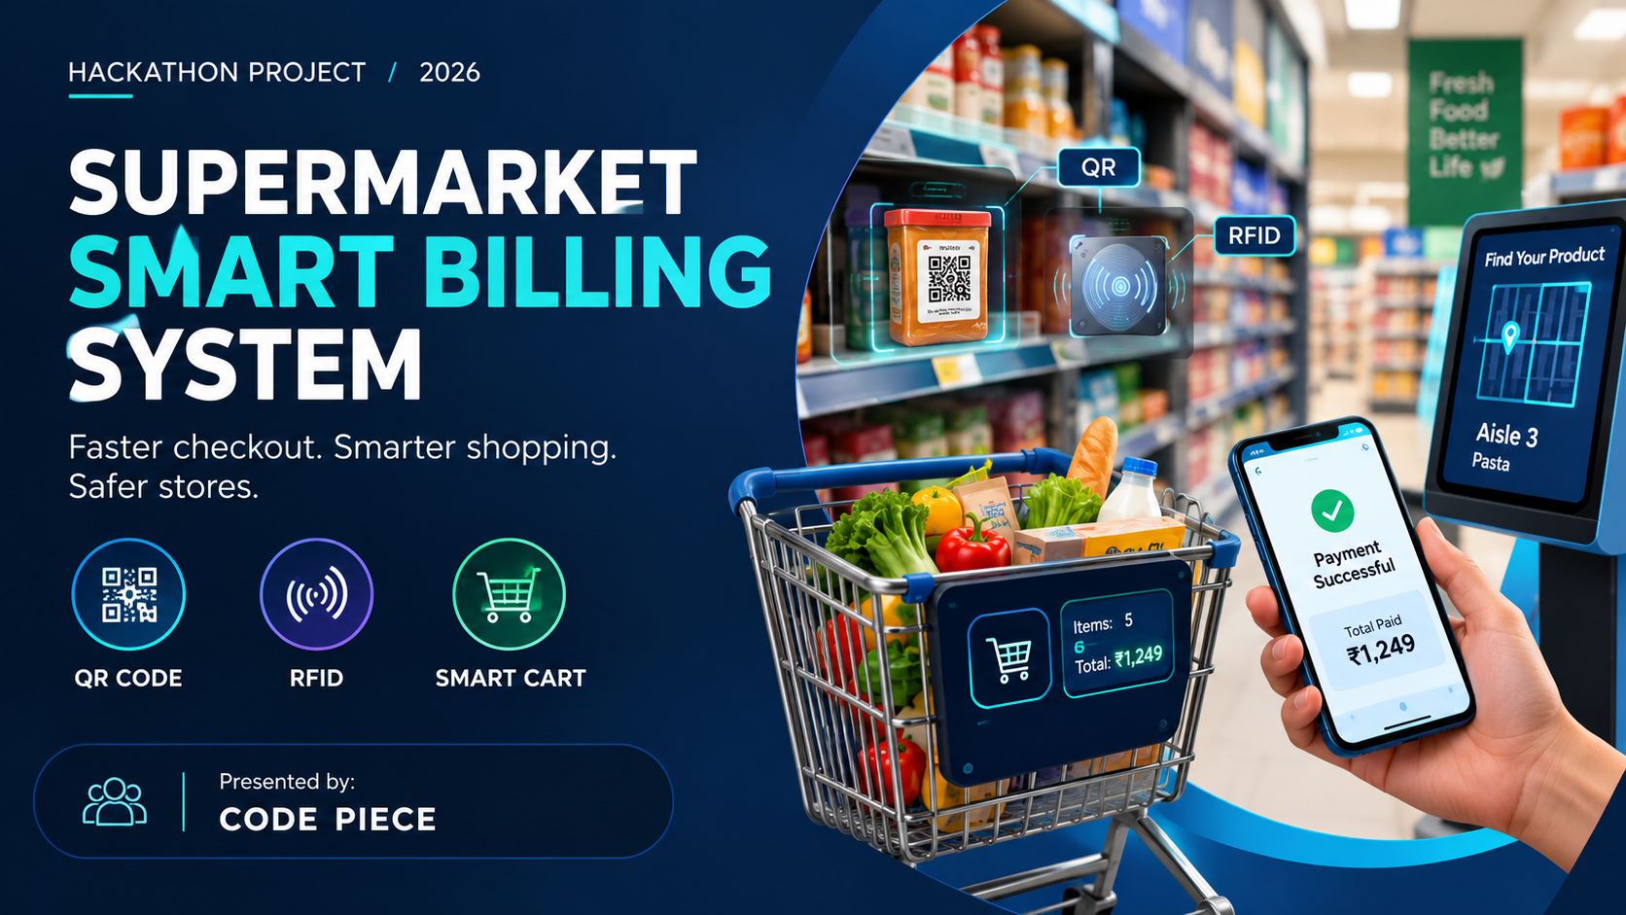

Slide 2
02 / SMART BILLING
The Problem: Checkout Takes Too Long
A familiar customer pain point creates a store-wide operational problem.
⏱
Long queues
↻
Repeated handling
₹
Limited visibility
Manual scanning and payment steps slow down busy checkout counters.
Products are picked up, scanned, packed, and sometimes scanned again.
Customers may not know their running total until checkout.
Impact
Customer frustration and lost time
Peak-hour pressure on cashiers
Crowding can reduce the overall shopping experience
HACKATHON CONCEPT • SMART RETAIL
2

Slide 3
03 / SMART BILLING
Our Solution: A Connected Smart-Billing Journey
Combine QR-based product information, RFID-assisted identification, and digital payment.
01
02
03
04
05
Pick item
Identify
Live bill
Pay
Exit
→
→
→
→
Product carries QR / RFID identity
Smart cart or reader detects item
Cart display updates total
Customer confirms and pays
Receipt + security check
Goal: reduce checkout friction while keeping billing transparent and store security in the loop.
HACKATHON CONCEPT • SMART RETAIL
3

Slide 4
04 / SMART BILLING
Technology Stack: QR + RFID + App
Use each technology where it adds the most value.
▦
QR code
◉
RFID tag + reader
▣
Billing app + database
• Low-cost printed code
• Scan to view product details
• Useful for customer self-check and fallback
• Radio-based tag identification
• Can read multiple tagged items quickly
• Supports inventory and exit-gate checks
• Product catalogue and prices
• Cart total, discounts, and tax rules
• Payment status and e-receipt
Design note: QR requires a camera and line of sight; RFID needs compatible tags/readers and careful tuning.
HACKATHON CONCEPT • SMART RETAIL
4

Slide 5
05 / SMART BILLING
How It Works: From Shelf to Receipt
A simple flow keeps the customer informed at every step.
1
Register item
Scan QR or detect RFID tag.
2
Validate product
Look up SKU, price, and offers.
3
Update cart
Add item and recalculate total.
4
Review & pay
Customer confirms bill and pays.
5
Verify exit
Receipt / payment token supports exit check.
✓ DIGITAL RECEIPT
HACKATHON CONCEPT • SMART RETAIL
5

Slide 6
06 / SMART BILLING
Bonus Feature: Find Products in the Store
An aisle map can guide shoppers to the right shelf and reduce wandering.
⌕
Search product
Example: “Pasta” → Aisle 3
↗
Route guidance
Show aisle, shelf zone, and path
✓
Live cart status
Found item can be added to the bill
START
ITEM
Prototype note: start with a static store map; add indoor positioning only if hardware and budget allow.
HACKATHON CONCEPT • SMART RETAIL
6

Slide 7
07 / SMART BILLING
Security & Loss Prevention
RFID can support verification—but it should not be the only security control.
✓
Paid-bill check
!
Exception handling
🔒
Privacy by design
Exit reader compares detected tagged items with the paid transaction.
Flag mismatches for staff review instead of automatically accusing a customer.
Use limited data, secure access, and clear customer notices.
Important safeguards
Test RFID read accuracy around metal, liquids, and crowded carts.
Provide a manual checkout / staff-assisted path for failed reads.
Protect payment data; use a trusted payment provider and avoid storing card details.
HACKATHON CONCEPT • SMART RETAIL
7

Slide 8
08 / SMART BILLING
Expected Benefits & How We Measure Them
Treat these as pilot targets to validate—not guaranteed results.
⏱
Checkout time
≋
Queue length
Measure median time per basket
Count people waiting at peak times
✓
Billing accuracy
★
User satisfaction
Compare cart contents with final bill
Short customer feedback survey
Pilot success = faster checkout + accurate bills + customers who trust the process
HACKATHON CONCEPT • SMART RETAIL
8

Slide 9
09 / SMART BILLING
Prototype Plan & Feasibility
Build the smallest working demo first, then expand based on test results.
PHASE 1
PHASE 2
PHASE 3
PHASE 4
Clickable demo
→
QR billing
→
RFID pilot
→
Evaluate
Store map, product search, mock cart and receipt.
Product QR labels, phone scan, price lookup.
Reader + sample tags, item matching, exit test.
Timed trials, accuracy tests, user feedback.
Demo hardware (optional)
Smartphone camera + printed QR labels
RFID reader and sample passive tags
Laptop / cloud database, test payment sandbox
HACKATHON CONCEPT • SMART RETAIL
9

Slide 10
10 / THE VISION
Less waiting.
More shopping.
A practical smart-retail concept that brings together quick product identification, transparent billing, product-finding guidance, and responsible security.
QR = accessible
RFID = fast identification
Smart app = clear billing
Thank you • Questions?
Presented by: [Your Name / Team]
10

Slide 11
10 / BUSINESS BENEFITS
Potential Annual Labour-Cost Savings
Smart billing can reduce routine checkout workload and let staff focus on customer support, replenishment, and store operations.
₹6–19 lakh+
Actual savings depend on store size, staffing levels, adoption, and the costs of deploying and maintaining the system.
Indicative potential savings per store / year
GROCERY CASHIERS
FLOOR / AISLE ASSISTANTS
₹15,000–₹22,000 / month
₹18,000–₹25,000 / month
Illustrative staffing impact: 2–5 roles per shift
Annual salary per person: ₹1.8–₹2.64 lakh
Illustrative staffing impact: 1–3 roles per shift
Annual salary per person: ₹2.16–₹3 lakh
Store-owner benefit: lower checkout workload • better staff allocation • smoother customer flow
Note: These are rough estimates from the supplied reference, not verified industry averages or guaranteed savings. Validate with local salary and staffing data.
SUPERMARKET SMART BILLING SYSTEM • HACKATHON CONCEPT

Slide 12
11 / CUSTOMER BENEFITS
Shop More. Wait Less.
QR-based self-billing aims to reduce time spent waiting at traditional checkout counters.
25–30 min*
47 min*
LIVE TOTAL
Less waiting
More time to shop
Clear, easy billing
Customers scan items, review their bill, and pay through the app.
Spend more time choosing products instead of standing in a queue.
See the running total and receive a digital receipt.
*Time figures are estimates from the project concept and should be validated with customer research.
12

Slide 13
12 / STORE-OWNER BENEFITS
Lower Workload. Smarter Operations.
Automate routine billing tasks and help staff focus on customers and store operations.
₹6–19 lakh+
SMARTER TEAM
LESS QUEUING
Potential cost savings
Better staff allocation
Improved store flow
Illustrative annual labour-cost savings per store; actual results vary.
Staff can support shoppers, replenish shelves, and manage inventory.
Fewer checkout bottlenecks may improve the shopping experience.
Savings are estimates, not guaranteed. Validate local salaries, staffing needs, and deployment costs.
13

